Slide 1
Genomic dissections of inflammatory proteins
https://jinghuazhao.github.io/INF/
On behalf of the SCALLOP/INF1 consortium
16/5/2019

Slide 2
Introduction
The vital role of inflammation is well-established in immune response and increasingly recognised in a range of pathological processes and diseases (Genz et al 2016, Niewczas et al. 2019).
The Olink/inflammation proteins combined with genomic data offer great opportunities to investigate the underlying biology (Sun et al. 2018). We here conducted genomewide association meta-analysis on Olink/Inflammation proteins from 12 studies within the SCALLOP consortium.

Slide 3
Study information
Name | Design | N
NSPHS | population study Sweden | 866
MadCam | rheumatoid | 185
STABILITY | atherosclerosis | 2951
STANLEY swe6 | bipolar, depression | 300
STANLEY lah1 | bipolar, depression | 344
BioFinder | dementia | 1496
RECOMBINE | rheumatoid | 860
Estonian Biobank | population study Estonia | 487
INTERVAL | blood donors England | 4902
KORA F4 | population study Germany | 1064
ORCADES | population isolate Orkney | 981
VIS | population isolate Croatia | 899
Total |  | 15335

Slide 4
Olink Proximity Extension Assay (PEA) technology
Multiplex immunoassays that measure 92 proteins across 96 samples simultaneously using only one microliter of serum, plasma, etc.
A pair of oligonucleotide-label(l)ed antibodies (“probes”) are allowed to pair-wise bind to the target protein present in the sample in a homogeneous assay, with no need for washing. When the two probes are in close proximity, a new PCR target sequence is formed by a proximity-dependent DNA polymerization event. The resulting sequence is subsequently detected and quantified using standard real-time PCR.
from https://www.olink.com/data-you-can-trust/technology/

Slide 5
Statistical analysis
Proteins. inverse normal transformed Olink/inflammation.
Genotypes. 1000Genomes, HRC or UK10K+1000Genomes imputed genotypes.
Model. Additive genetic model with adjustment for sex, age, principal components and/or cohort-specific covariates.
Meta-analysis. Per-SNP meta-analysis on effect sizes through METAL.
Independent signals. PLINK clumping and joint/conditional analysis with GCTA. 1. Both 1000Genomes and individual level genotype data from INTERVAL were used as LD reference panels; 2. Both Genomewide and by approximately independent LD (AILD) blocks; 3. Bonferroni correction on genomewide significance ~ 5e-10.
Other downstream analysis such as PhenoScanner.

Slide 6
Association analysis for KORA
Pilot with success/failure with BOLT-LMM on OPG/TNFSF14.
Switch to SNPTEST on transformed measurement ~ age+sex+PC1-PC5, where PCs were derived from pruned SNPs.
Exclusion of six related individuals.
INFO score was compared between SNPTEST and qctool –snp-stats.
Final sample size N=1,064.
Several disruptions on cardio/TRYGGVE and FGF.5 for #SNPs.

Slide 7
Meta-analysis (METAL)
TACKPOSITIONS/CUSTOMVARIABLE with 2018-08-28 release.
~ 36hr on TRYGGVE.
No GC correction (polygenicity/population stratification) on individual studies.
Effect size-based (as composed to the p-value based counterpart).
N>=10.

Slide 8
Meta-analysis as quality control
The majority of sumstats are satisfactory.
However, there were a small number (~20) of problematic proteins according to QCGWAS, with which Manhattan plots were produced for each protein from each cohort. It appeared that the total number was a function of MAF, from ~20 at 0.03 to 3 at 0.1.
The QC over IFN.gamma is given below as example.
QCGWAS.
Information from cohort on those proteins links to LLOD.
Exclusion from METAL.
Eventual Manhattan plot.

Slide 9

Manhattan plots (QCGWAS)

Slide 10

Q-Q plot (QCGWAS)

Slide 11

IFN.gamma ylim=c(0,25) (qqman)

Slide 12
Associate information on LLOD
An attempt was made by using llod/2.
~20 busy Manhattan plots (excessive number of significant hits) were closely related to this.
Although higher MAF cutoff could do away with busy Manhattan plots, it is unusual to do so and the associate proteins with low >LLOD% were discarded.

Slide 13
Busy Manhattan plots and % (above LLOD)
Protein | % | Protein (continued) | % (continued)
L.15RA | 0.841 | IL13 | 0.062
ST1A1 | 0.808 | IL.20RA | 0.057
MCP.3 | 0.804 | IL.24 | 0.051
FGF.5 | 0.652 | IL.20 | 0.046
AXIN1 | 0.425 | NRTN | 0.039
IL.17A | 0.380 | ARTN | 0.035
IL.17C | 0.369 | IL.1.alpha | 0.025
IL4 | 0.171 | IL.2RB | 0.023
IL5 | 0.162 | IL33 | 0.014
IL.10RA | 0.149 | IFN.gamma | 0.007
TNF | 0.096 | TSLP | 0.005
LIF | 0.064 | IL.22.RA1 | 0.003

Slide 14

IFN.gamma from >1,000 signals to none (qqman)

Slide 15
Identification of near-independent signals
1KG (built from LocusZoom 1.4 at TRYGGVE and also curated databases at cardio), and UK10K+1KG as LD references, with balanced (in silico experiment) and comparable parameters, i.e., PLINK --clump-r2 0.1 can also give overlap with approximately independent LD bocks (see INF1.UK10K+1KG.AILD.r2-0.1.ranges). GCTA --cojo-collinear 0.9 gives near-independent (primary + secondary as described by Yengo et al 2018) signals. Ultimately both were subject to AILD blocks.
INTERVAL and INF1 share similarity in both number of signals and cis/trans classification, while UK10K+1KG reference panel gave more signals than 1KG.

Slide 16
Statistics on AILD blocks
The predefined 1703 autosomal regions have flanking distances #SNPs correspondence such that are 250kb (36), 500kb (300) and 10mb (1701), which are close to GCTA but +53 (PLINK) signals.
Exclude regions with high LD including HLA, giving 1672 regions.
Overlap regions with GWAS sumstats to 233 protein-region pairs.
Obtain near-independent signals by PLINK and GCTA.
Conduct downstream analysis: cis/trans classification and PhenoScanner annotation.

Slide 17
Results
Manhattan, Q-Q, LocusZoom and forest plots.
Identification of near-independent signals with 1KG, UK10K+1KG (INTERVAL genotypes) and contrast with INTERVAL.
cis/trans classification of signals.
Replication of findings on OPG (Kwan et al. 2014) through PhenoScanner, initially v1.1 and later v2.

Slide 18

375 Signals
355 primary+20 secondary signals.
Proteins |  | Signals
only cis pQTLs |  | 12
only trans pQTLs |  | 14
both cis and trans |  | 43
no pQTL |  | 22
220 cis/155 trans signals, excluding 35 signals from regions in high LD.

Slide 19
Annotation by PhenoScanner
PhenoScanner v1.1. esp. on OPG by Kwan et al. (2014).
PhenoScanner v2 results for INF1 as a whole and by proteins.
Additional results on IBD, rheumatiod arthritis.

Slide 20


Manhattan (L) and Q-Q plots (R) for OPG

Slide 21

Regional plot (OPG, chr8)

Slide 22

Forest plot (OPG, chr8)

Slide 23

Forest plot (OPG, chr17)

Slide 24
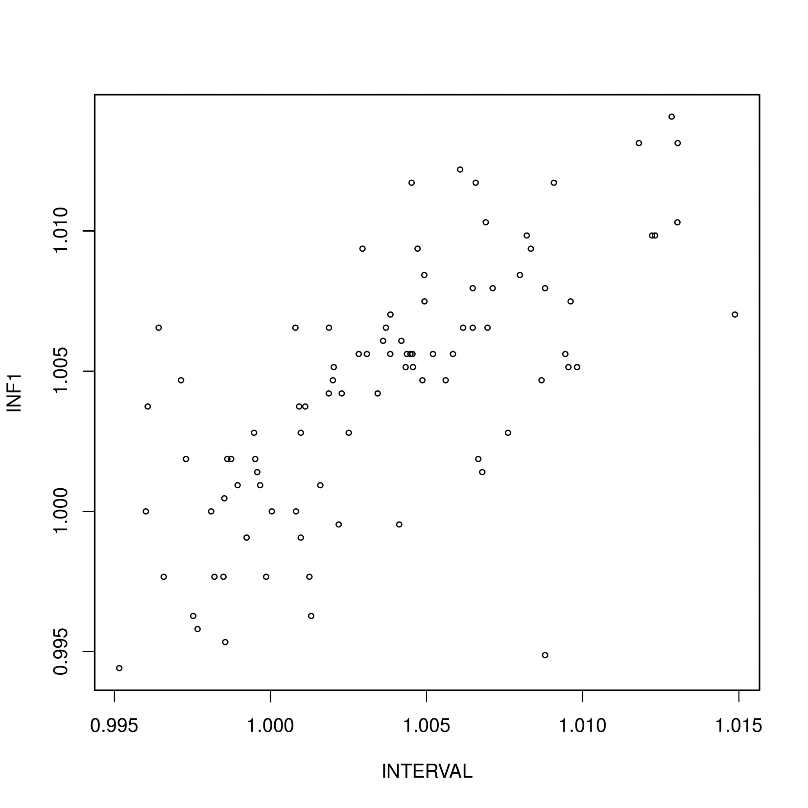
λGC

Slide 25


Effect size ~ MAF (L) and b/bJ (R, r=0.93)

Slide 26
Conclusion
The joint/conditional analysis took full advantage of the approximately independent LD blocks which resolves the uncertainty in LD-window specification. The specific findings on OPG (and also TNFSF14, IL12B, not shown) were just examples that we would be able to replicate earlier work but on a greater scale. The findings will corroborate with related work on broad spectrum of proteins as reported in Sun et al. (2018) as well as findings related to inflammation on the SomaScan panel used (Niewczas et al. 2019).
The website https://jinghuazhao.github.io/INF/ provides information which will also facilitate analysis from other panels in the SCALLOP consortium. Other downstream analysis will be reported separately.

Slide 27
Outlook of the analysis
Discovery, replication – INTERVAL, meta-analysis, NSPHS.
Near-independent signals. PLINK –clump is based on p-value and r2 with more signals than GCTA –cojo analysis, both within AILD blocks with the same prospect for finemapping – PLINK, GCTA, finemap, and JAM, among others.
Effect size/AF plot and in relation to power/winner’s curse – INTERVAL vs INF1.
Additional information on genotyping and cohort characteristics needs to be requested for the paper.
Further downstream analysis with PhenoScanner, ProGeM(?) and MR.
Elementary summary statistics such as h2 from INTERVAL, with KORA relatively small for GCTA and possibly with INF1 for HESS. This was examined by Kwan et al. (2014) whose results on OPG were replicated from the analysis.

Slide 28
Additional aspects
Between-cohort MAF-MAF plots.
P ~ N (for finemapping) and consistency, e.g. INTERVAL/STABILITY.
False negative for those in the CVD1 panel to PhenoScanner.
Chr19. NLRP12 from INTERVAL.
Total # signals relative to other panels.

Slide 29
References
Ganz P, et al. (2016). Development and risk score for based risk score for cardiovascular outcomes among patients with stable coronary heart disease. JAMA 315:2532-41
Kwan JSH, et al. (2014). Meta-analysis of genome-wide association studies identifies two loci associated with circulating osteoprotegerin levels. Hum Mol Genet 23(24): 6684—93.
Niewczas MA, et al. (2019). A signature of circulating inflammatory proteins and development of end-stage renal disease in diabetes. Nat Med https://doi.org/10.1038/s41591-019-0415-5
Sun B, et al (2018). Genomic atlas of human plasma proteme. Nature 558: 73-9.
Yengo L, et al. (2018). Meta-analysis of genome-wide association studies for height and body mass index in ∼700 000 individuals of European ancestry. Hum Mol Genet 27:3641–3649

Slide 30
Acknowledgements
CEU. Adam, Jimmy, Bram.
SCALLOP. IT and TRYGGVE, Lasse, Anders.

Slide 31
Landmarks
14/5/19 – AILD results including PhenoScanner v2.
9/5/19 – BHF poster.
27/3/19 – cross-reference with INTERVAL on INTERVAL genotype data, which showed great similarity with INF1, esp. w.r.t. cis signals.
8/3/19 – Recognition of MAF cutoff on IFN.gamma, IL.22.RA1, TSLP.
29/11/18 – 22 proteins with busy Manhattan plots.

